Slide 1



Spike-Time Dependent Plasticity Learning Techniques for Event-Based Signals
Supervisor: prof. M. Rossi
Co-Supervisor: dott. R. Mazzieri
Gianmarco Lattaruolo

Slide 2
Table of contents
SNN
Intro
Motivation
Leaky Integrate-
and-Fire Neuron (LIF)
LIF Derivation
Spike Timing-Dependent Plasticity (STDP)
STDP Derivation
Implementation and Properties
Implementation and Properties
Building blocks
Notes:
This is the outline for today
I would like with a pair of images to understand the dimensional proportion of the brain
After, afterwards, later, subsequently
The two main types of unsupervised Hebb’s rules for learning
We won’t see neuron models for this presentation

Slide 3



Spiking Neural Networks: why?
Low power consumption
Fast Inference
Biological Plausibility

Slide 4
Spiking Neural Networks: how?
Spike
Spiking Neuron
Synapses

Slide 5
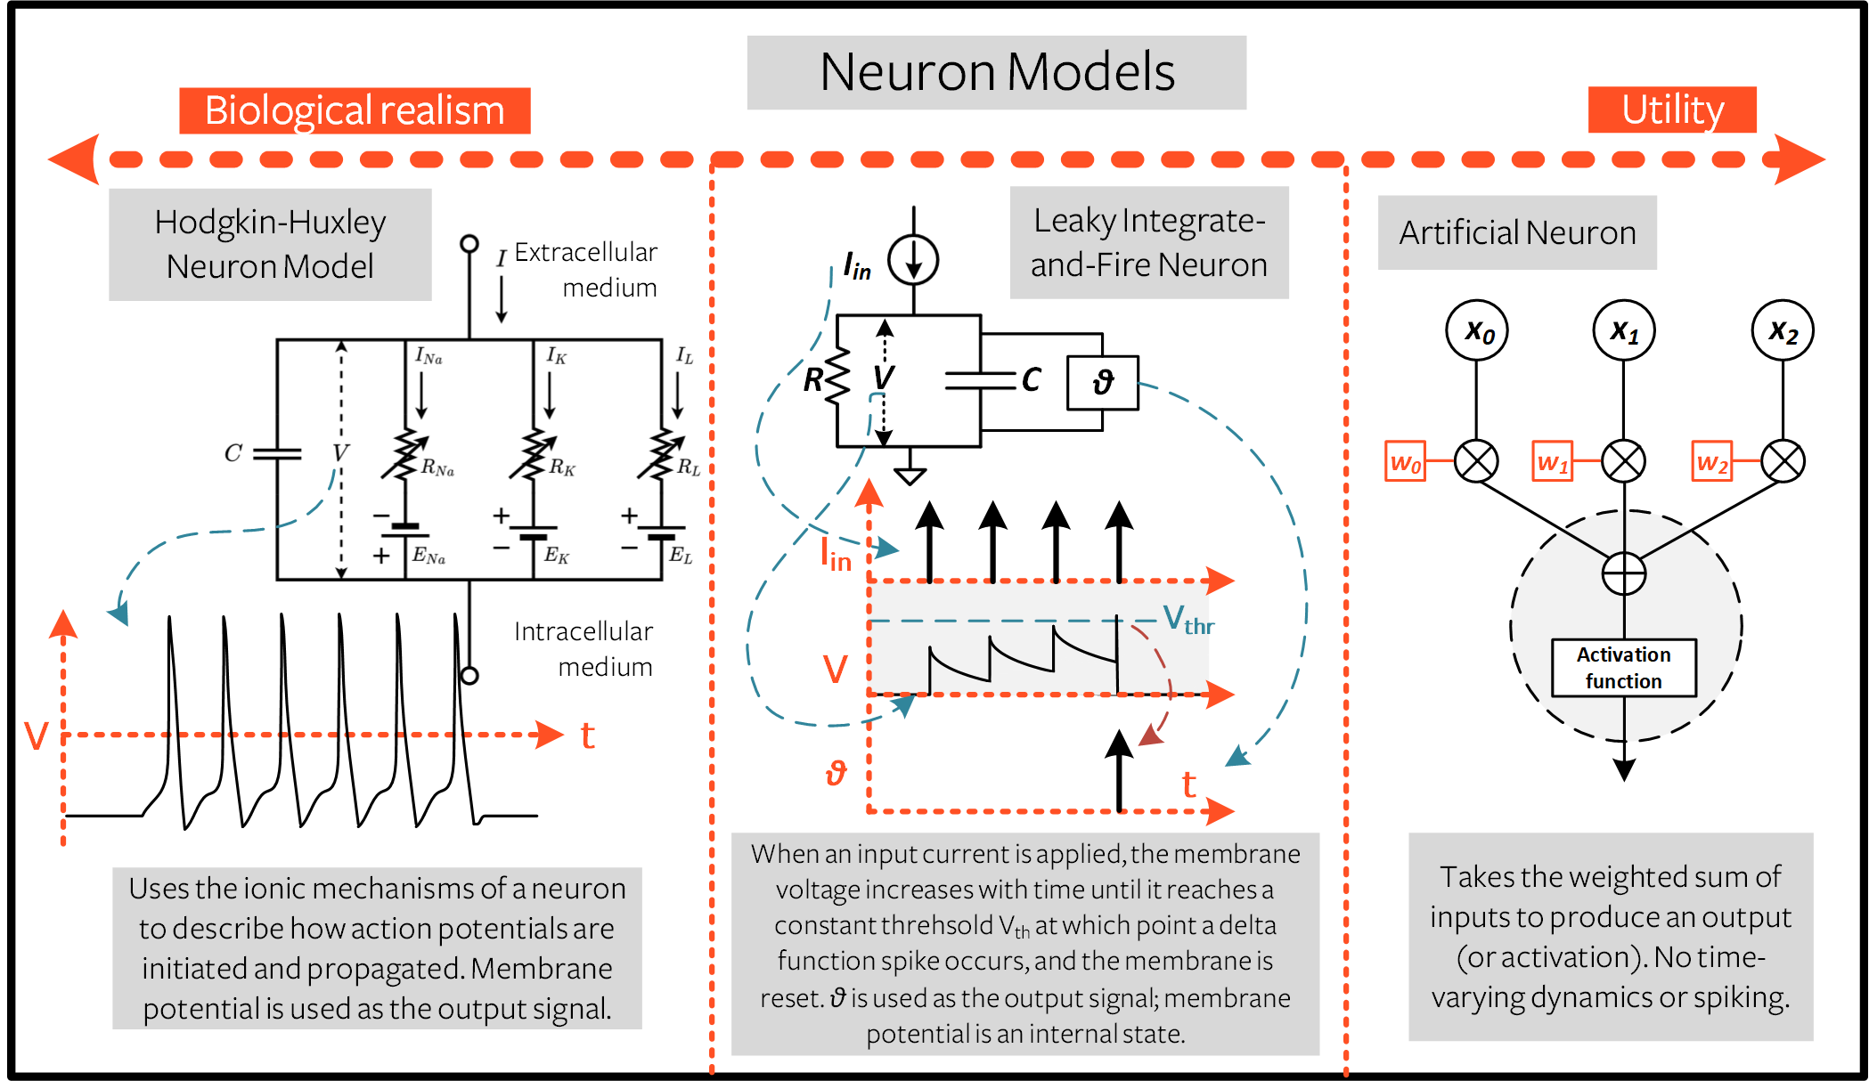
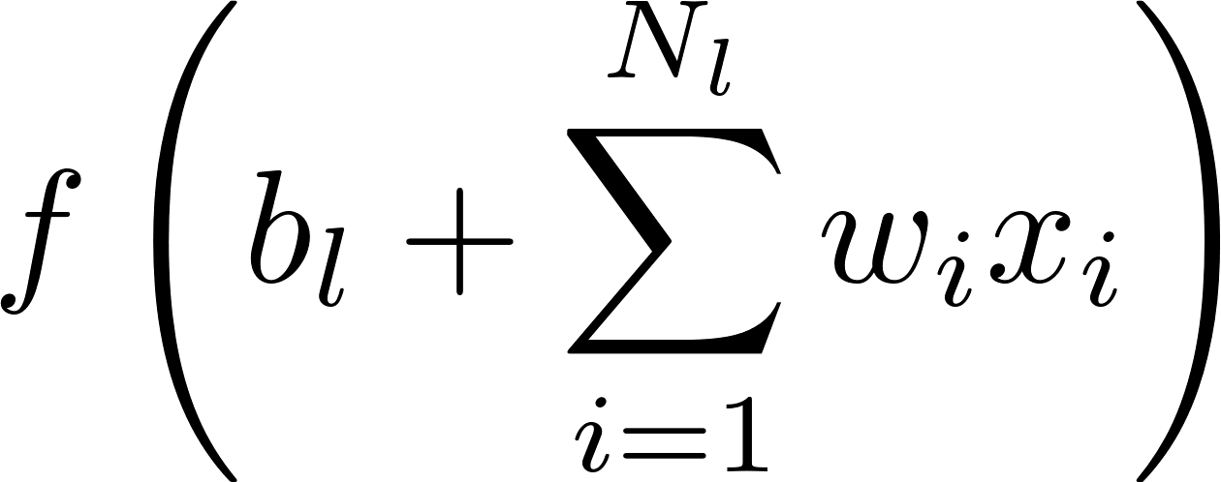
Choosing the neuron model
Hodgkin-Huxley
Neuron Model
Leaky Integrate-
and-Fire Neuron
Artificial Unit
Very Efficient
Not realistic
1 simple ODE
Good at replicating real signal, not at predicting
Computationally efficient
3 ions channels
Many ODEs
High realism

Slide 6
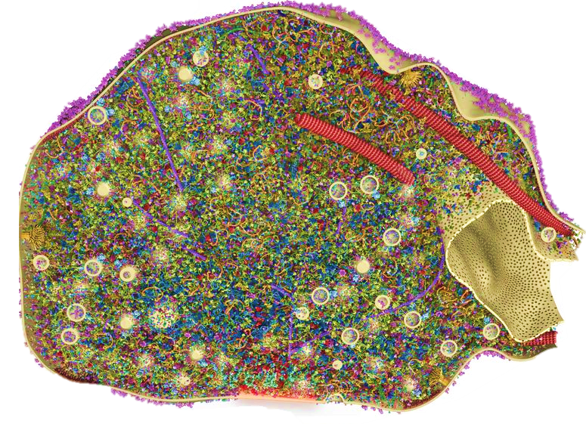
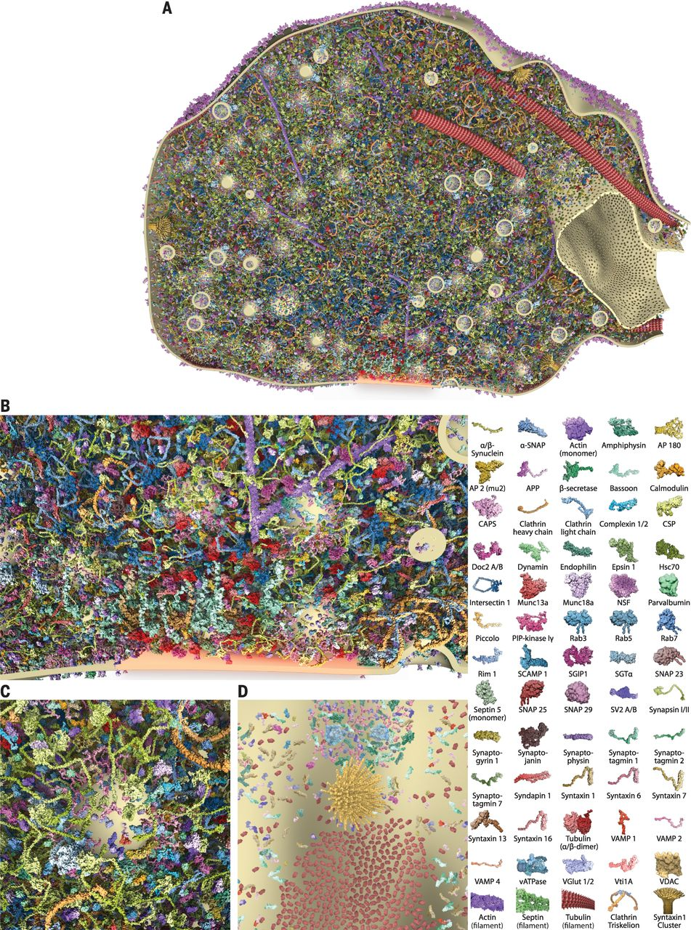


Synapses are stunningly complex
A section through the synaptic bouton
42nM
Benjamin G. Wilhelm et al., Composition of isolated synaptic boutons reveals the amounts of vesicle trafficking proteins.Science344,1023-1028(2014).
Notes:
This image really surprised me
This is an artificial image of a synaptic cleft section from a biomedical paper
all the tiny little figures inside it are proteins, and we have a legend on the left
Synapses are stunningly complex
The vesicles released by the synapses are 42 nanometers wide
And this is only the terminal portion of an axon of a neuron

Slide 7
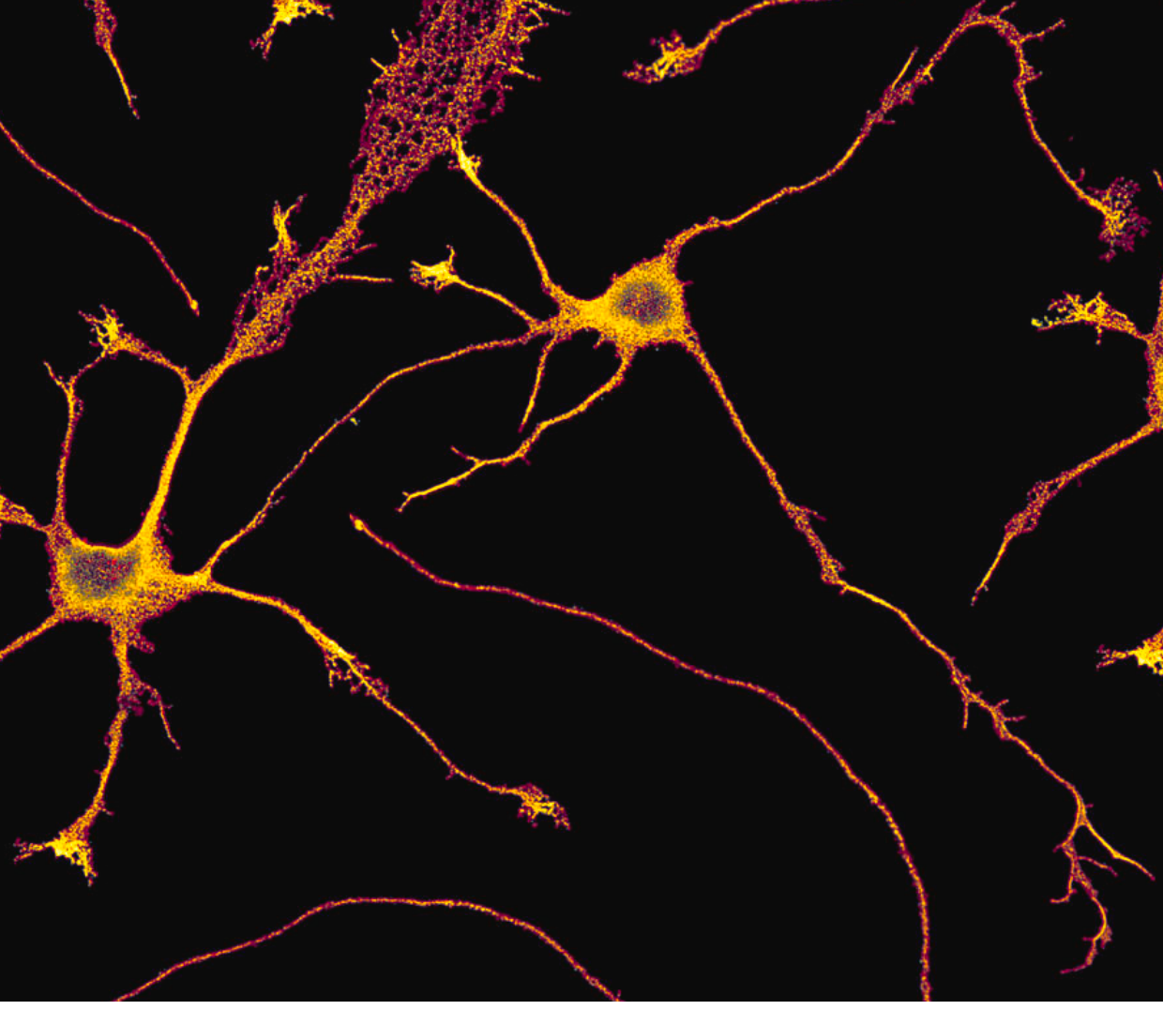
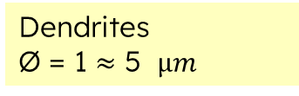
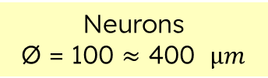
Dendrites and Neurons
Dendrites
Ø$\text{ = 1}≈\text{5 }μm$
Neurons
$$\text{Ø}\text{ = }\text{100}≈\text{400 }μm$$
Synapses
We can model the neurons and their processes at different levels of depth and complexity.
Notes:
This, on the other hand, is a microscopic picture of some neurons
The scale is passed from nanometers to micrometers
All this to say that:
The model we choose is based on the level of depth of our description which in turn is based on the task we have and, on the resources, available.
In our case this is the framework we are working in

Slide 8
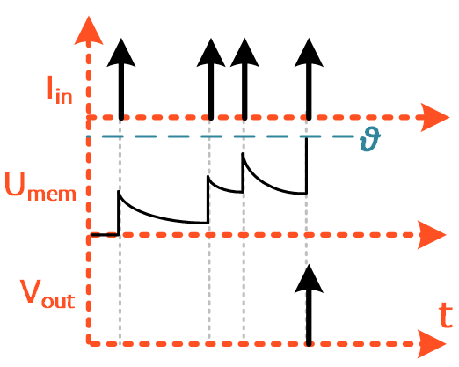
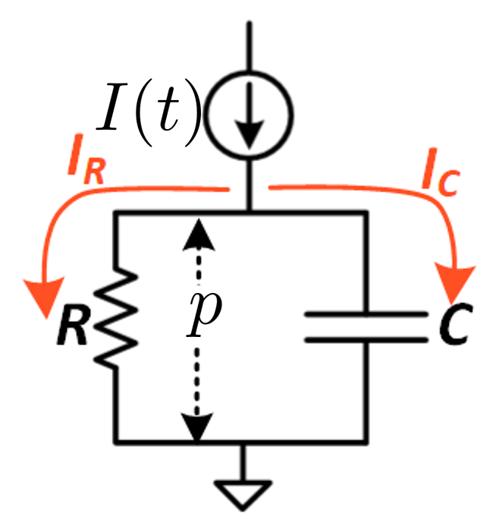
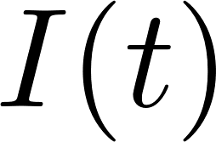
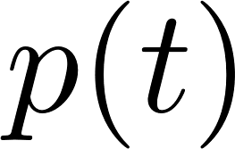


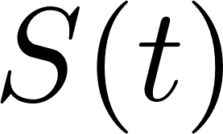

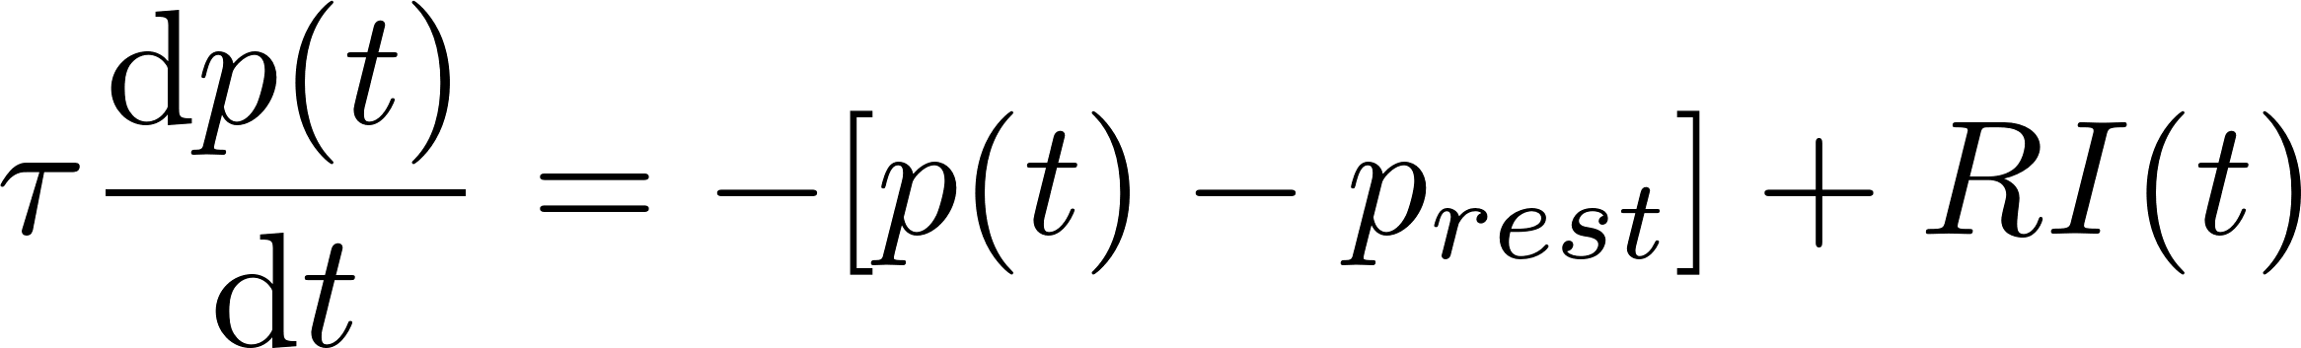
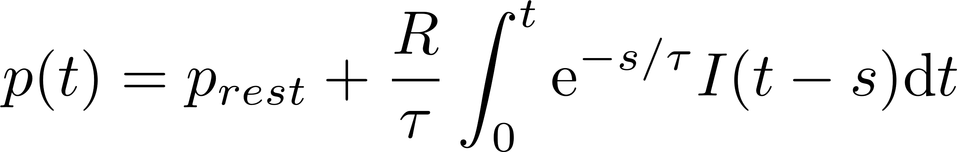
LIF Model
Input
Output
Neuron
Body

Slide 9
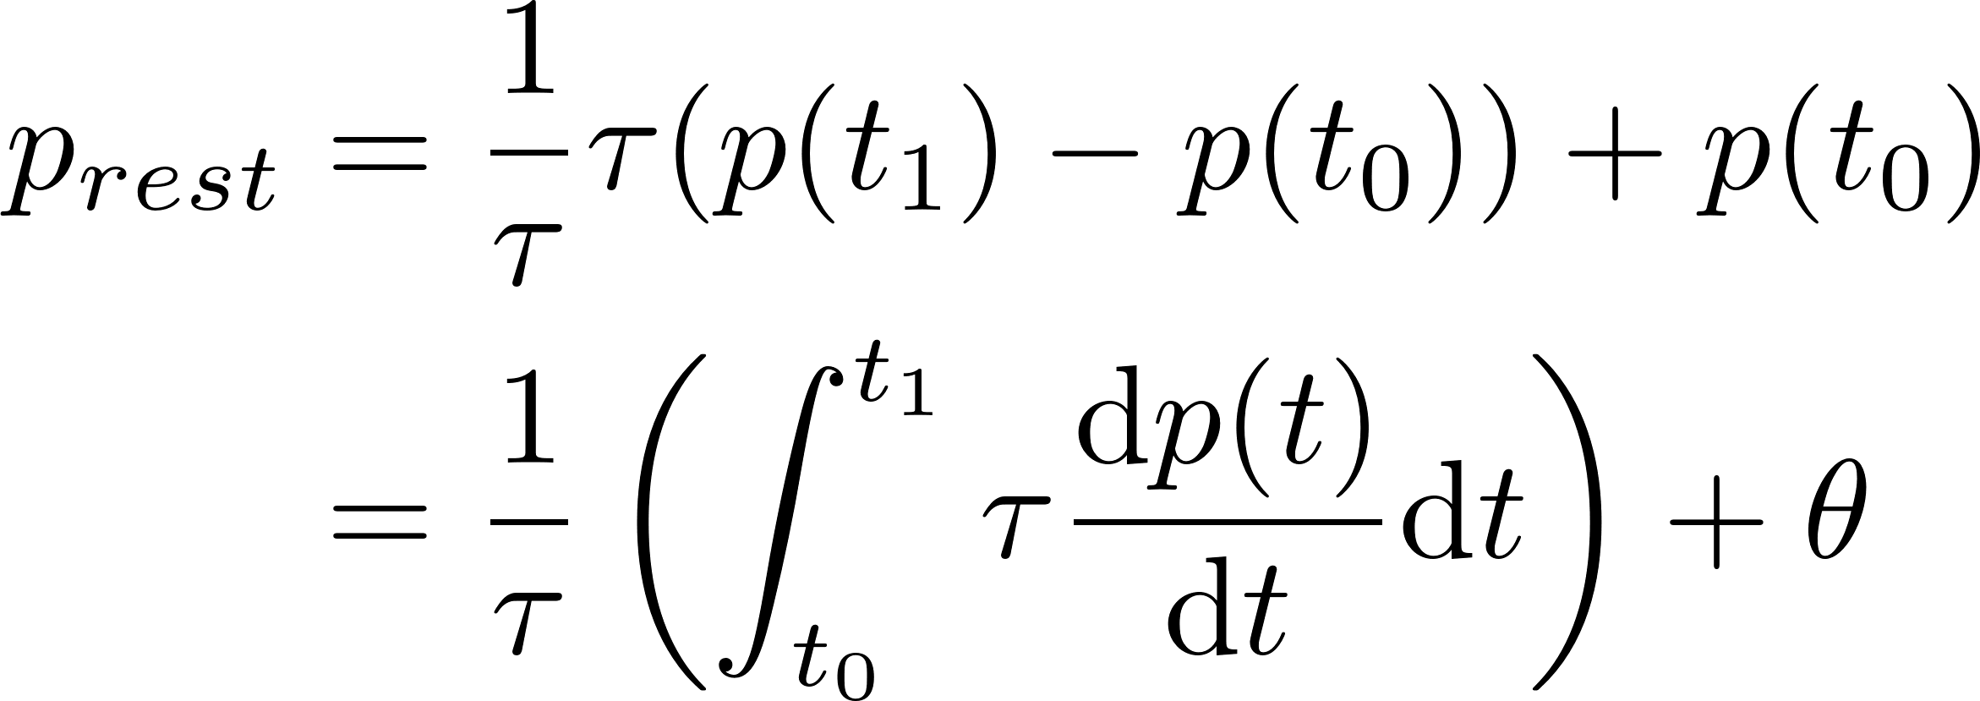


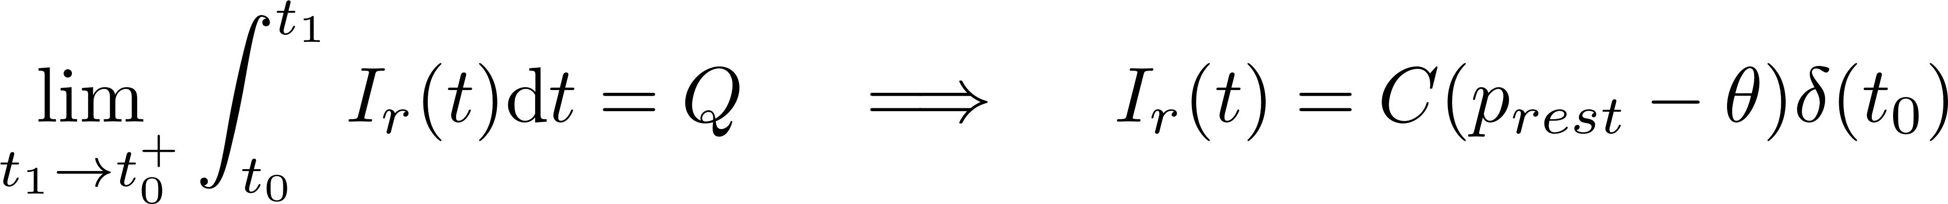
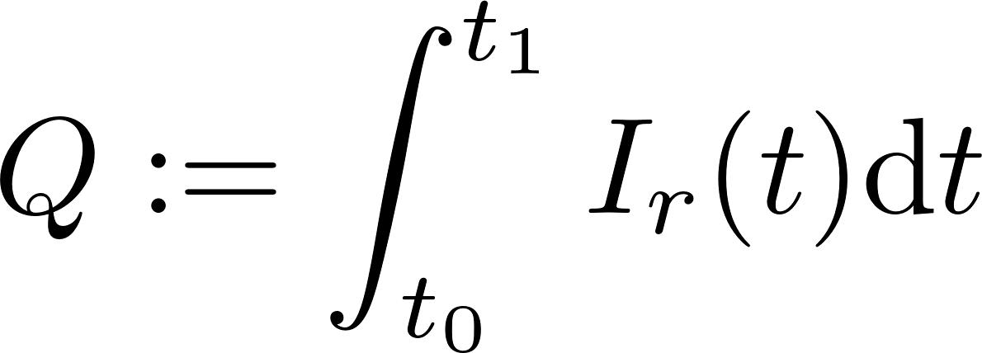
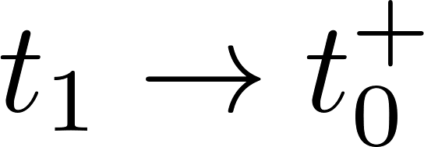

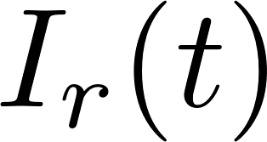
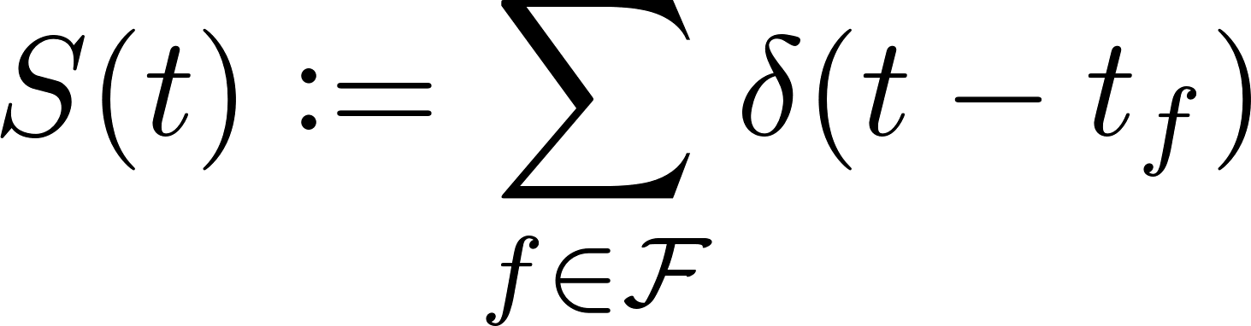
Reset Mechanism

Slide 10
Reset Mechanism

Slide 11
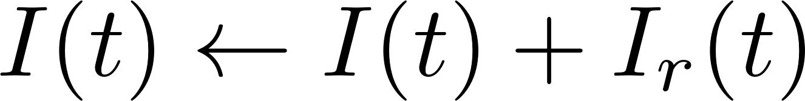

Reset Mechanism
Discharging current

Slide 12
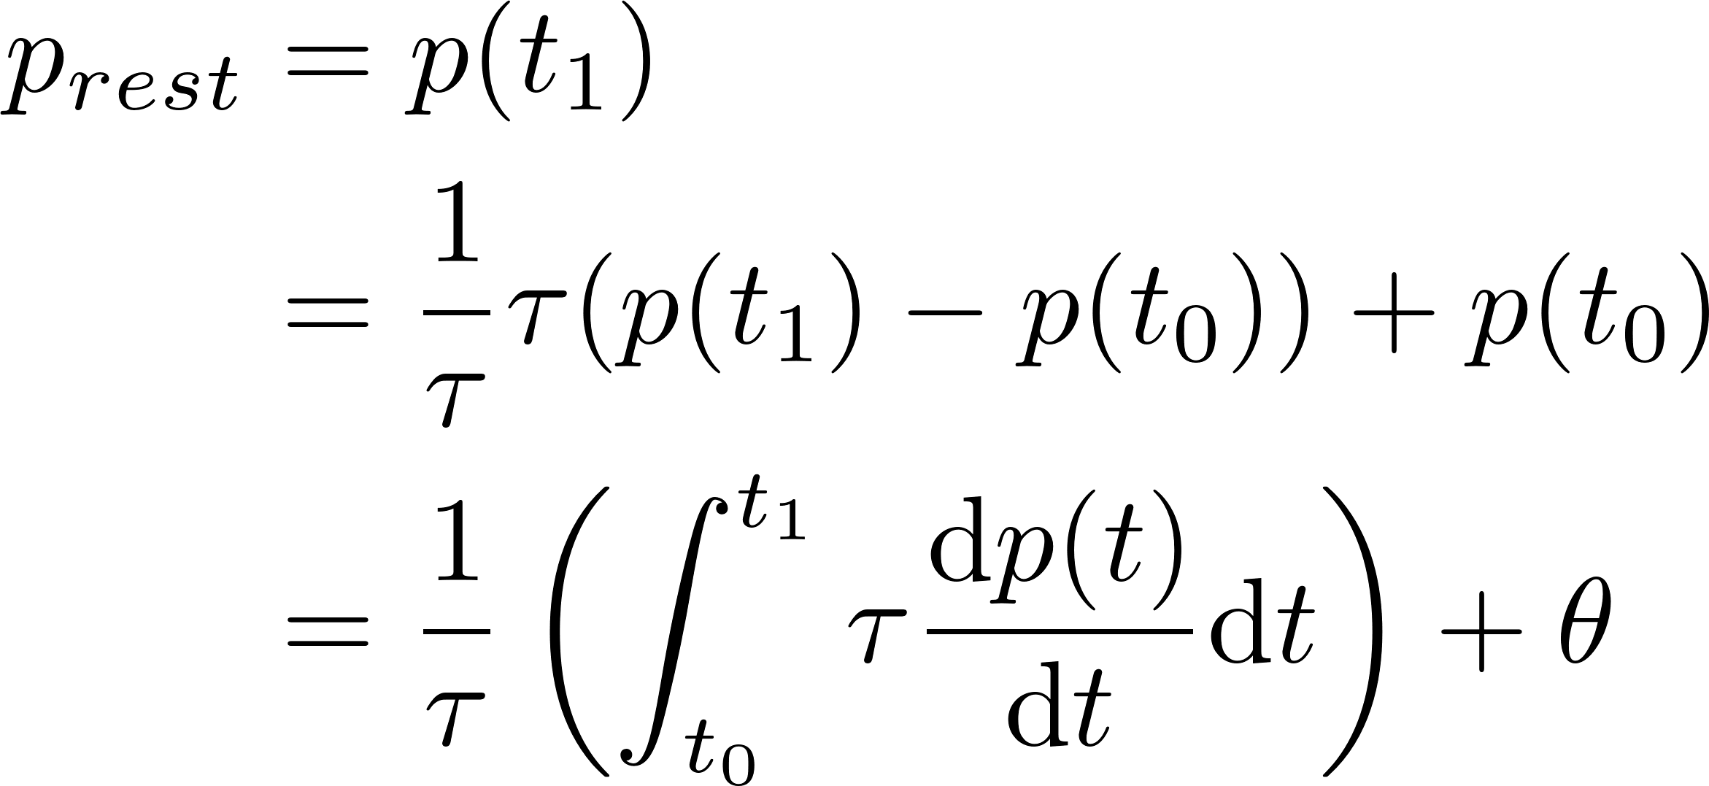
Reset Mechanism
Discharging current

Slide 13

Reset Mechanism

Slide 14
Reset Mechanism

Slide 15
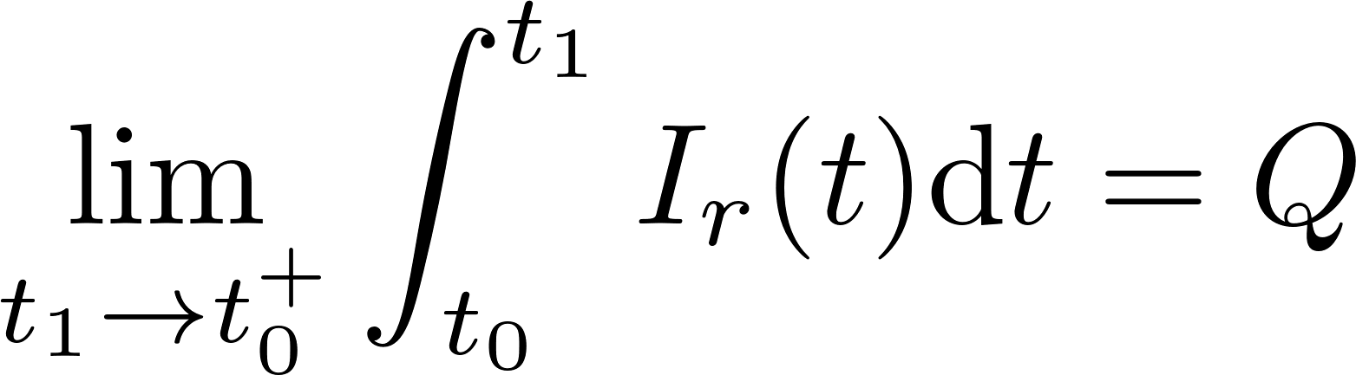

Reset Mechanism

Slide 16
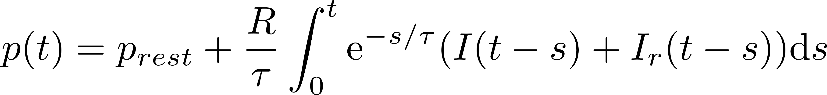
Reset Mechanism

Slide 17
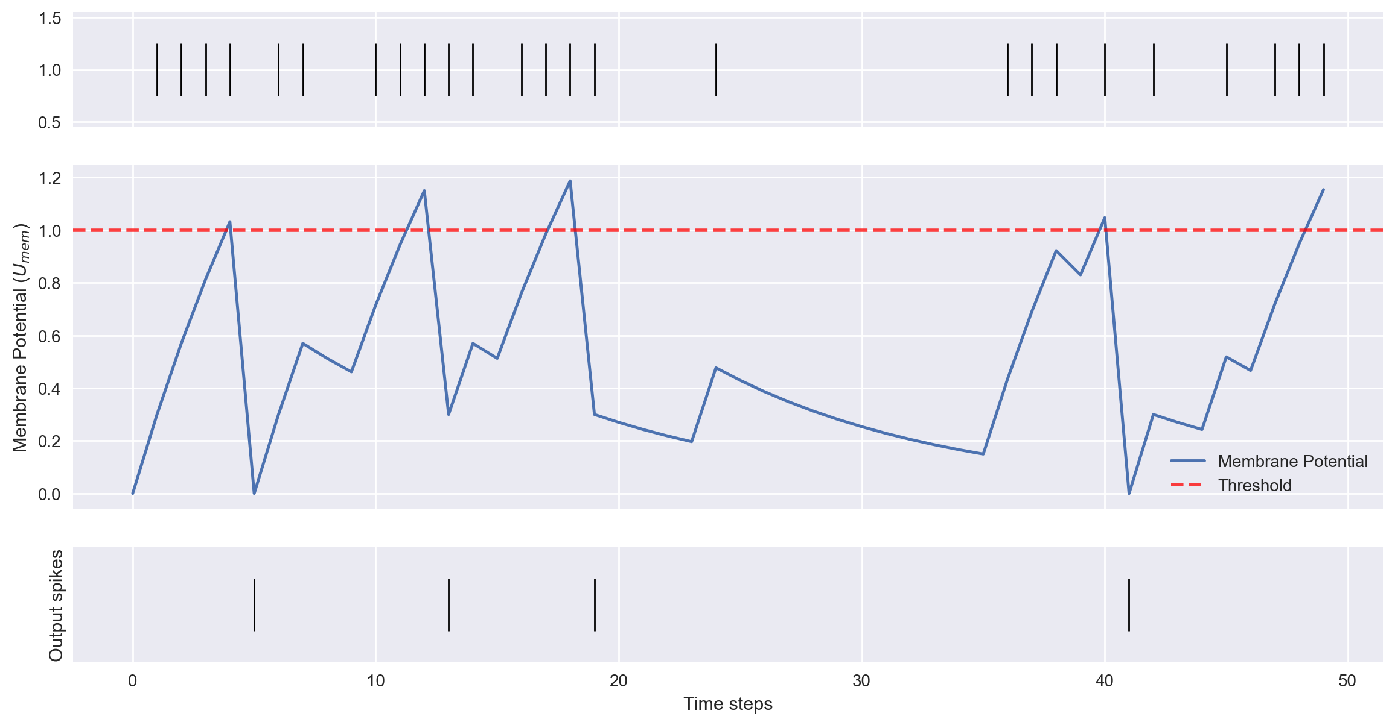
Reset Mechanism

Slide 18
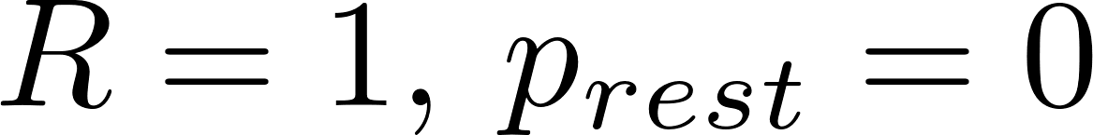



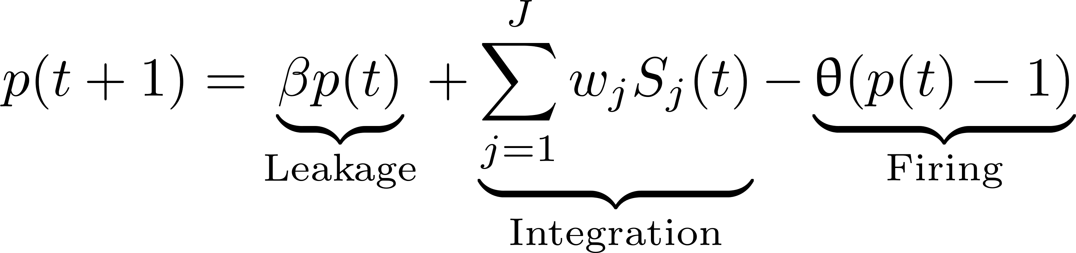
LIF implementation
Set
up to an affine transformation of
up to rescaling of
is the decaying factor
Discrete time steps with

Slide 19
LIF implementation
Set
up to an affine transformation of
up to rescaling of
is the decaying factor
Discrete time steps with

Slide 20
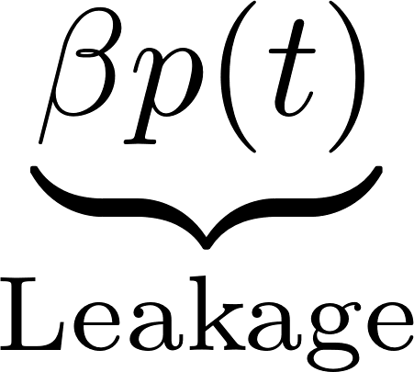
LIF implementation
Set
up to an affine transformation of
up to rescaling of
is the decaying factor
Discrete time steps with
Heaviside Step Function

Slide 21
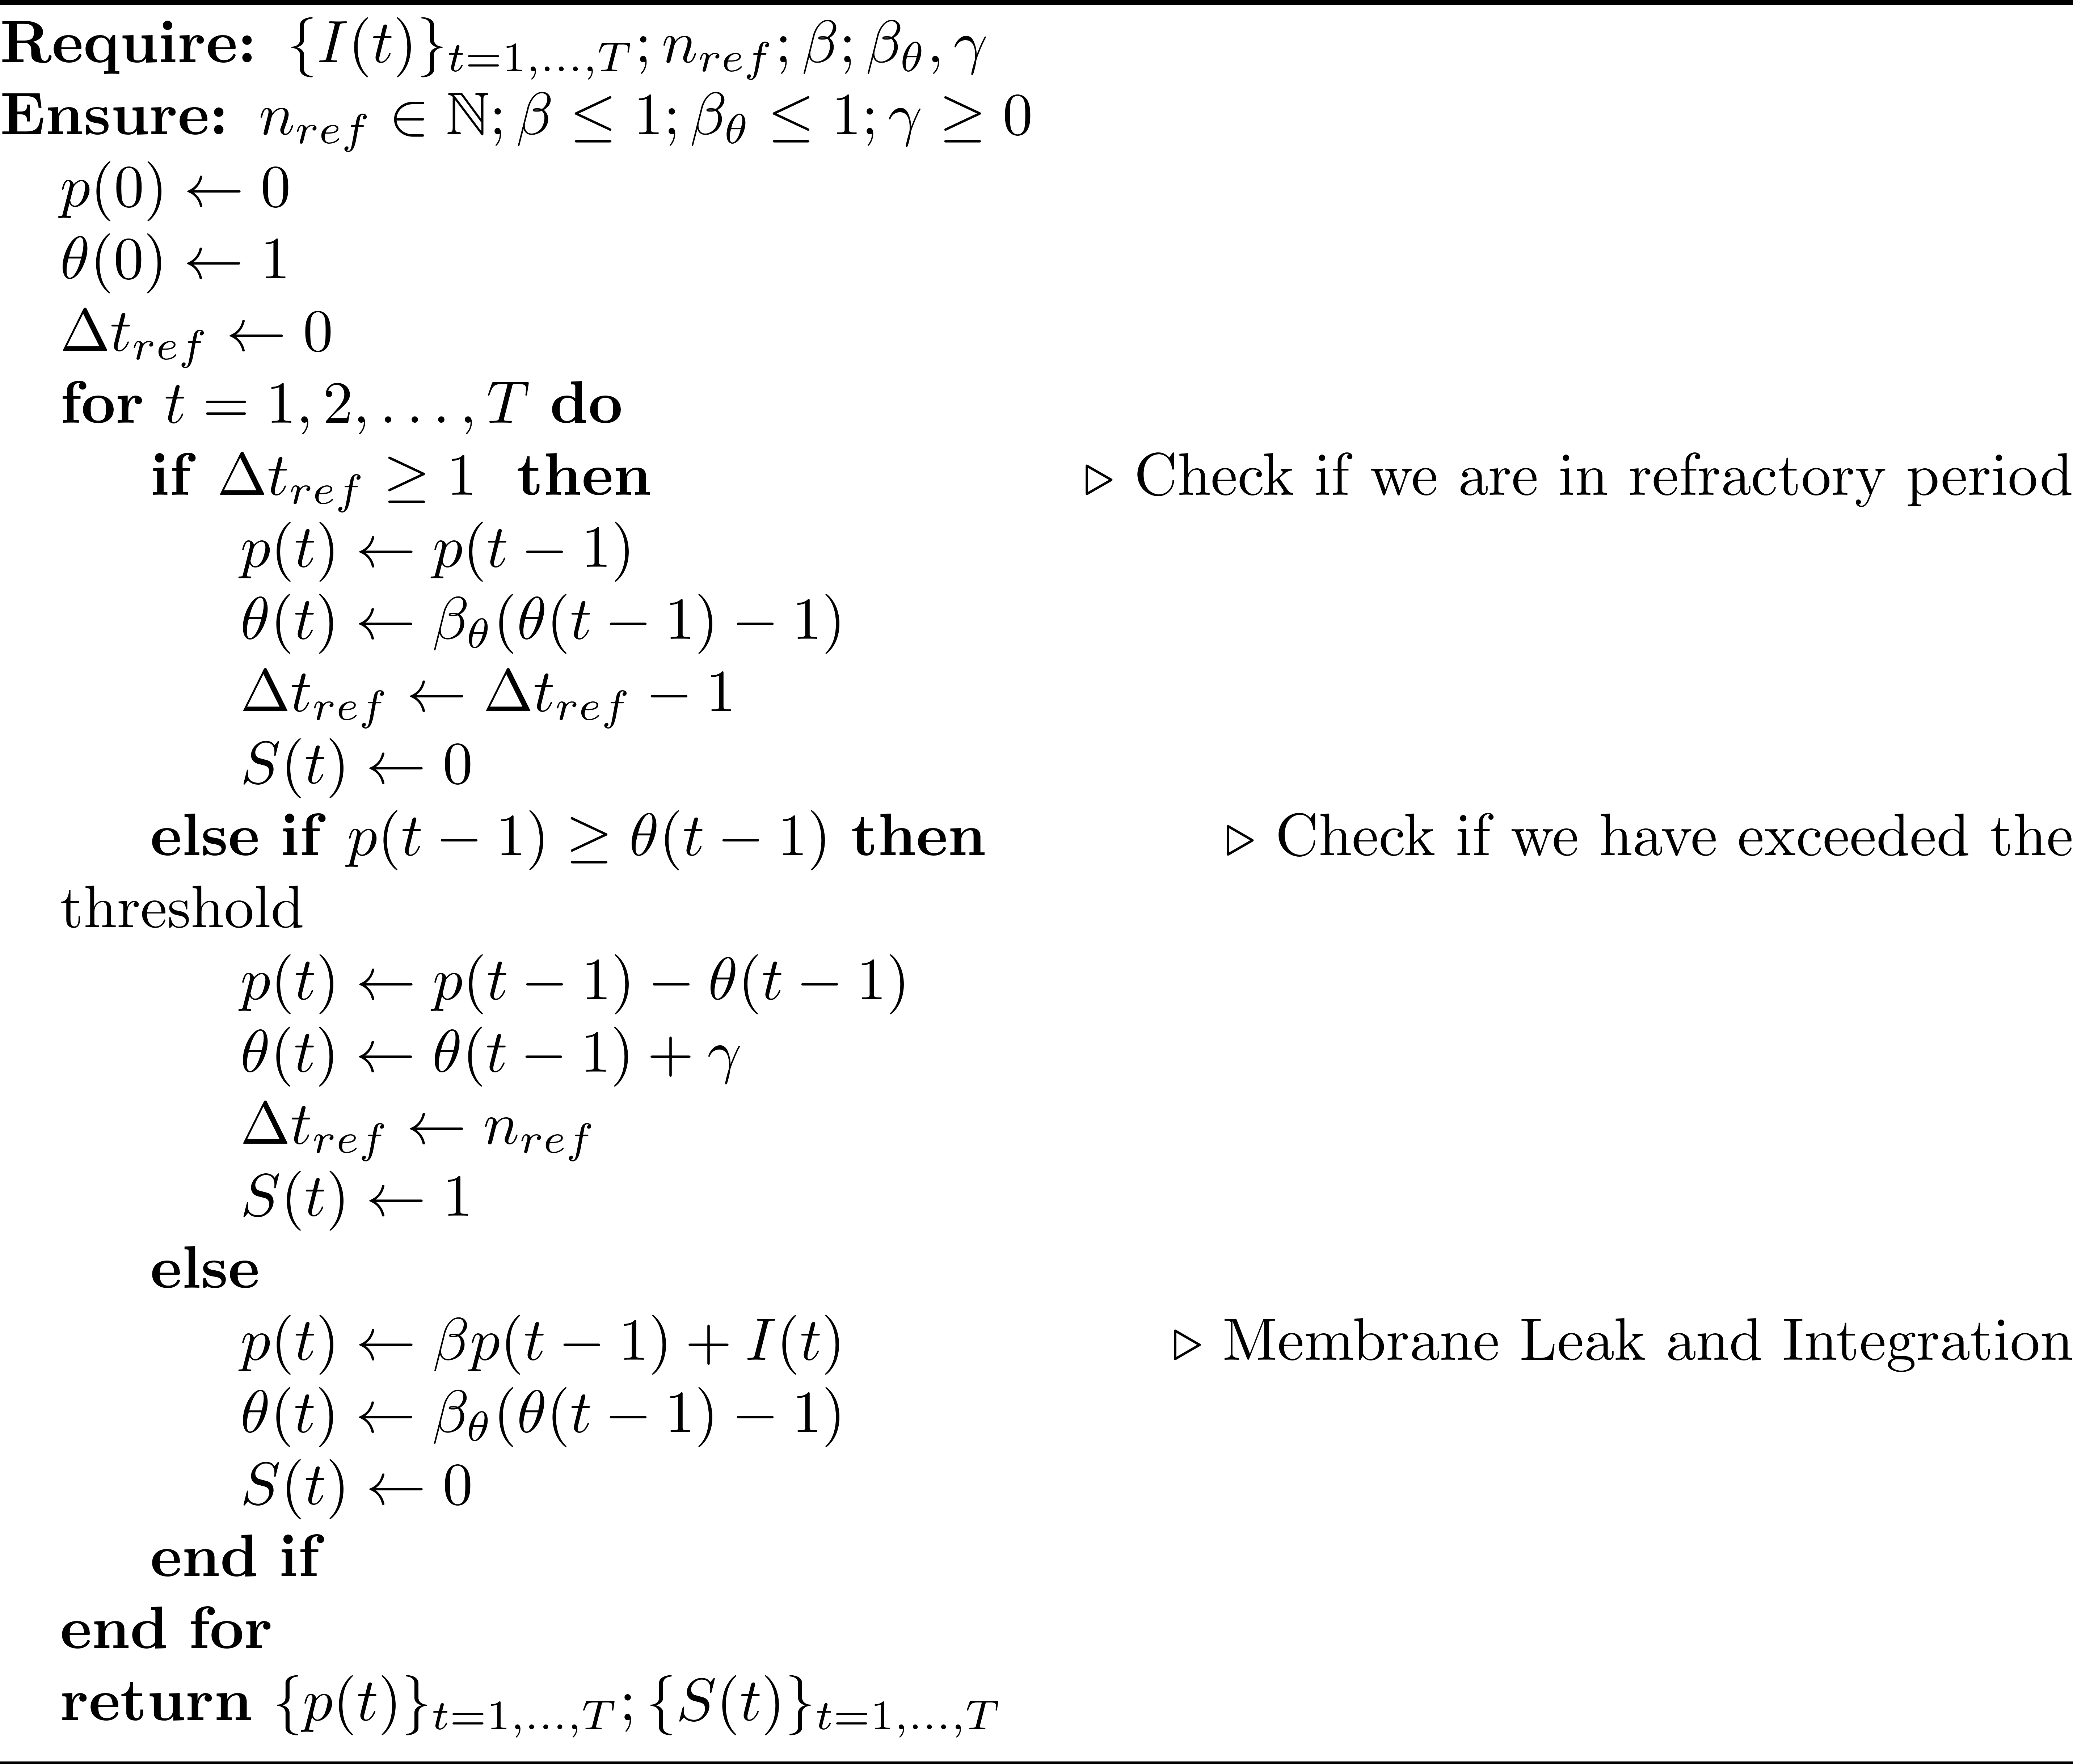
Notes:
This is the algorithm.
Notice that the ODEs of A and B have been discretized using the forward Euler method
The time steps usually corresponds to 1 millisecond or less and the value of the rime constants tau_plus and tau_minus must be changed accordingly
Moreover, notice that we don’t really need the entire spike train at the beginning of the for loop but just the value at that specific time. If we integrate the dynamic of the neurons inside the for loop we obtain fastest possible way to implement STDP, without even storing the history of changes in the weight.

Slide 22
Training SNNs
Shadow Training or ANN-SNN conversion
Backpropagation-based Training
Local Learning Rules

Slide 23
Training SNNs
Shadow Training or ANN-SNN conversion
Backpropagation-based Training
Local Update Schemes
Hebbian Learning Rules

Slide 24
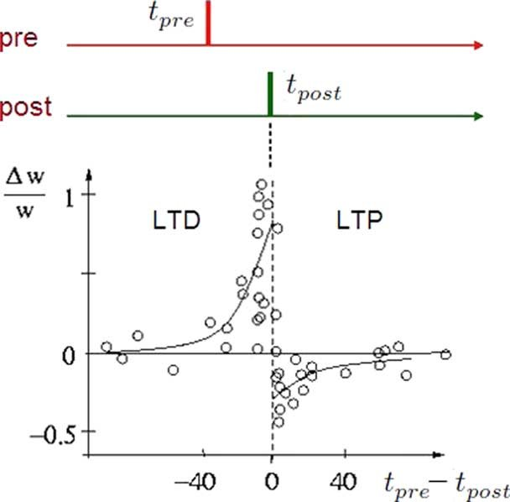
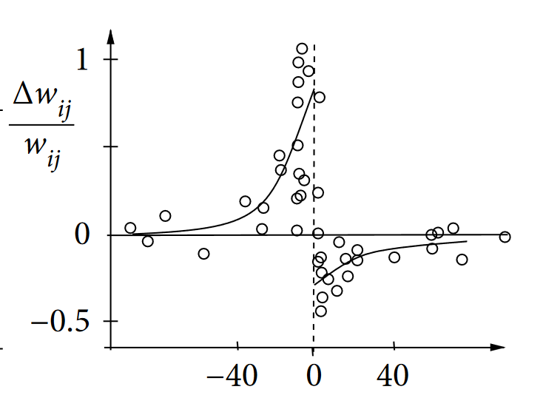
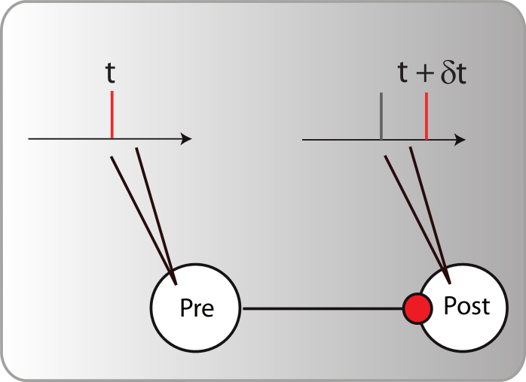

Spike-time Dependent Synaptic Plasticity
In vivo experiments to show the change in Excitatory Post-Synaptic Efficacy (EPSE)
Notes:
The Sike Time Dependent Plasticity is a biological phenomenon measured in vivo experiments of this type.
With two very small electrodes they measured the relative change in the Excitatory Post-Synaptic Efficacy before and after the two neurons have been stimulated forcing spikes at precise moments in time.
In the graph we see that if the presynaptic spike occurs after the postsynaptic one (so the difference is positive) the efficacy decreases and we have LTD.
In the other case we have LTP

Slide 25
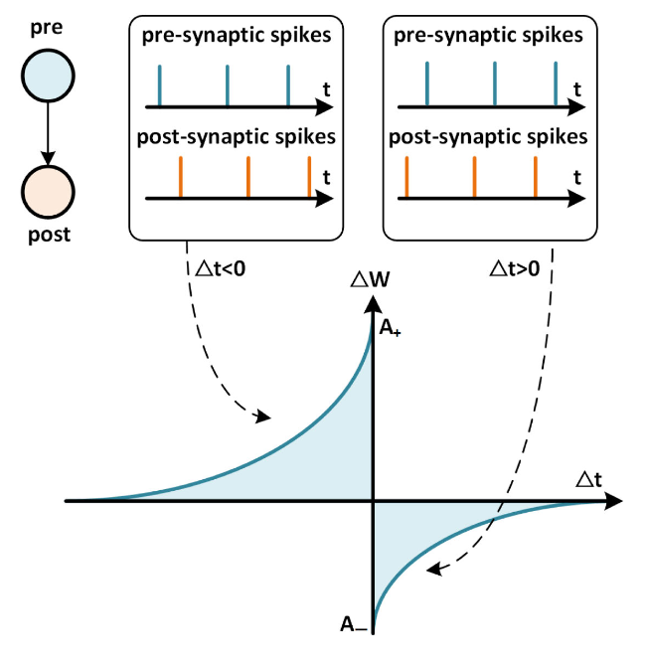
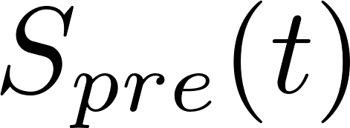
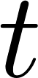

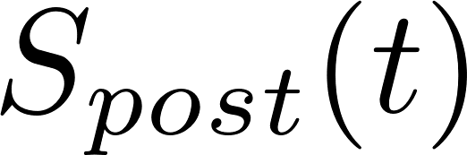




STDP learning window
Presynaptic neuron
Postsynaptic neuron
LTD
LTP

Slide 26
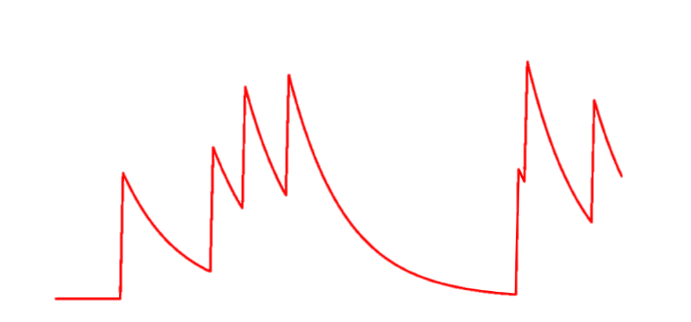
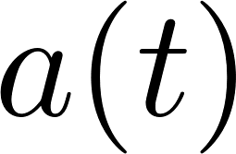
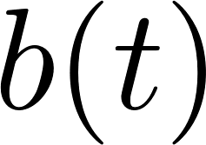
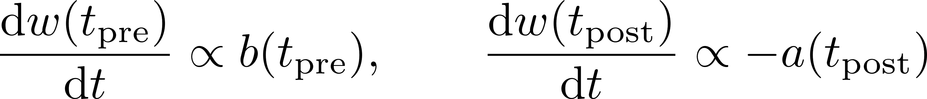
Derivation of STDP
Biologically Assumptions: pre- and postsynaptic neurons have synaptic traces ,
Hebb’s Assumptions: at presynaptic spike time, the postsynaptic variable affects the amount of change of the weight and vice versa i.e.
Notes:
We can derive STDP rule with simple mathematical assumptions
First of all experiments have shown that the neurons seem to have a synaptic trace, that we call with time dependent function a and b.
Disregarding their biological interpretation we are interested in modelling their behavior. Thus we assume that a_j increase by 1 at spike time of presynaptic neuron and otherwise decays exponentially with a certain time constant. And same for
With introduce an Hebbian like dependence in this way: whenever a presynaptic spike occurs the weight is changed proportionally to the value of postsynaptic trace and viceversa

Slide 27
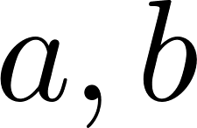
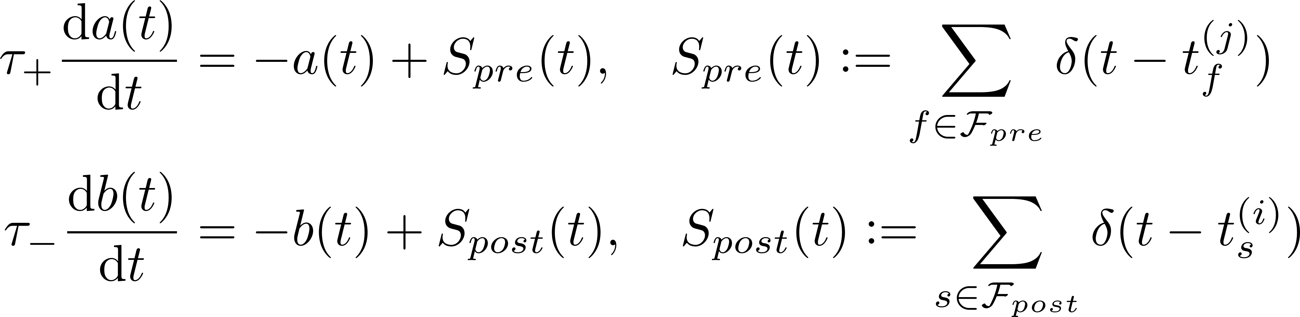
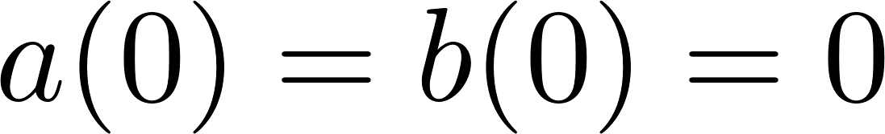
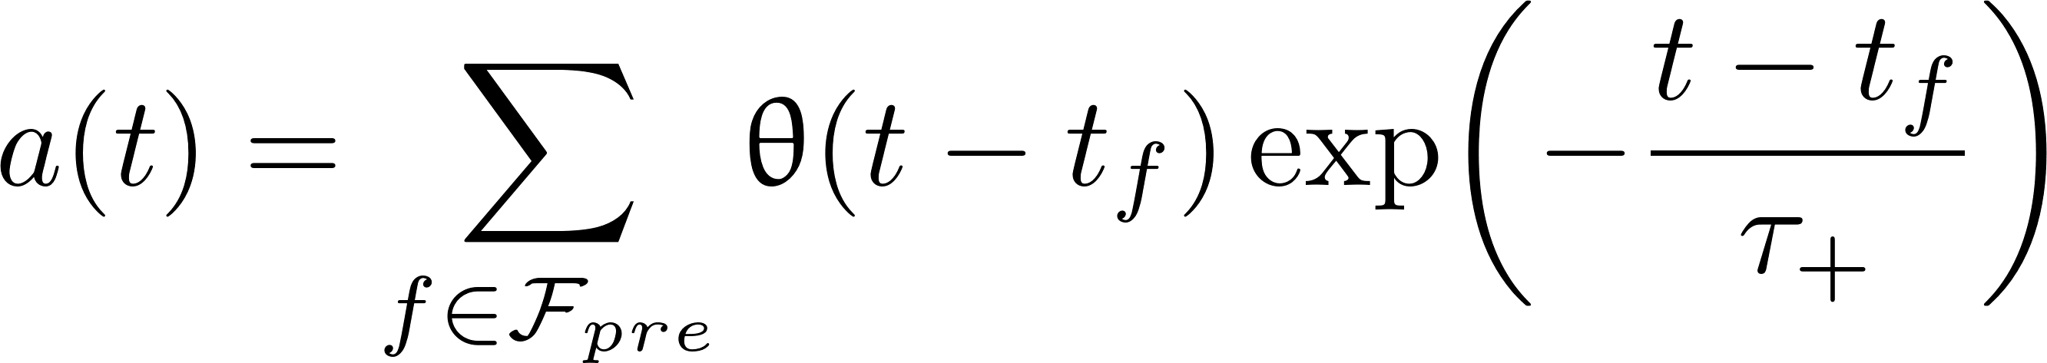
The ODEs for are
We can compute the exact solution assuming
and analogously for
Notes:
So we an easily write the two ODEs for a and b. Remind that S_i and S_j are the spike trains and are made of Dirac’s Deltas. Actually, at a specific time t at most 1 of the addend of this summations is different from zero, that is only if t is a spike time.
Assuming a zero initial value for a and b we can write the exact solution of these ODEs exploiting the Heaviside step function.
We can see in the images that in the end the synaptic traces are simply a summation of exponential decays at different times.

Slide 28
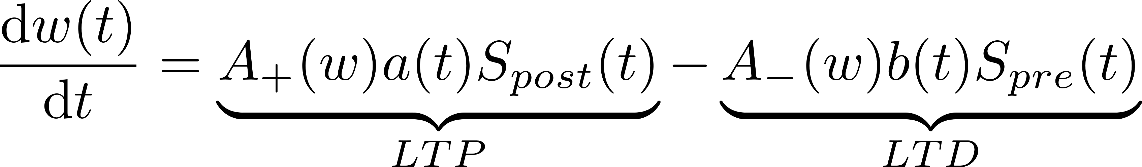
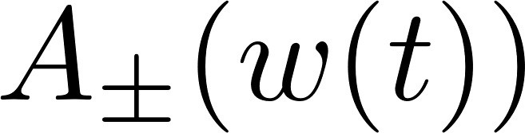

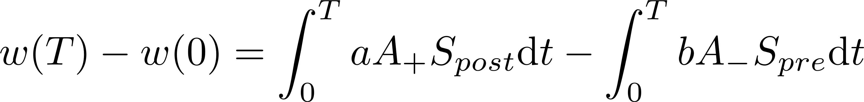
ODE for the weight update
are positive functions
We explicitly integrate to compute at time :
Notes:
Instead for the weight w_ij, taking into account the Hebbian assumptions of before, we have this ODE.
Each term is multiplied by a positive function describing the magnitude of change eventually based on the current weight. Note this function are usually constant values but they can modelled to prevent weight saturation as has done in the rate-based rules.
Now having the exact expressions for a and b and having the ODE for w_ij we can, in a brute force way, integrate to find the total change between time 0 and time capital T

Slide 29
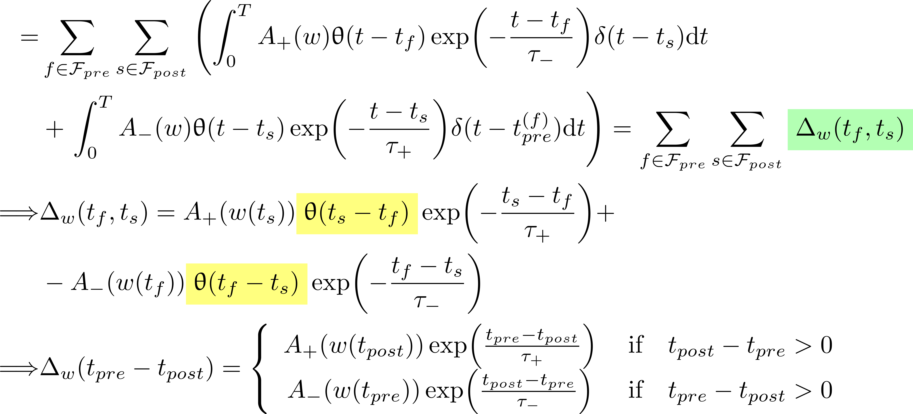
Notes:
I don’t want go through al this math but let me highlight to facts:
First we have a linear decomposition with a term for each pair of pre and post synaptic spike times, term that I called capital delta of w
Secondly the final results contains to Heaviside step functions with inverted arguments, this means that exactly one of these two addends is not zero. In this way we find the classical STDP update scheme for a pair of spikes

Slide 30

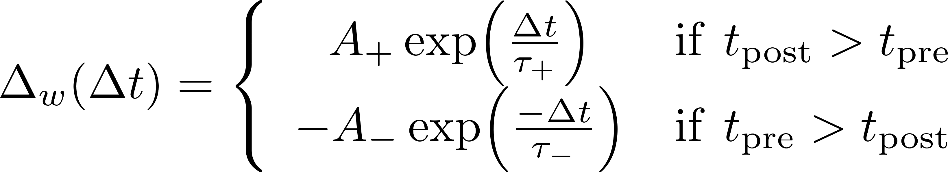
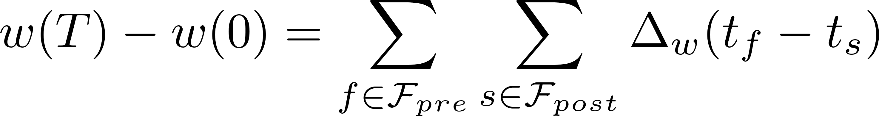
We have obtained the classic STDP rule for a pair of spikes
and the overall weight update at the and of simulation would be
Notes:
This update depends only on the difference of spike times and the overall change in weight is given by this not so friendly double summation.

Slide 31





The algorithm
Do we really use this formula?
Flops
Update the weight only at the end
Memory
Use the synaptic traces to achieve an optimized version
Flops
Memory
Notes:
So we may ask ourself: do we really use this formula? Which are the drawbacks?
First of all, doing this for all the pairs of presynaptic and postsynaptic neurons we should do this big O calculations
Moreover we have the update only at the end of the simulation, when there are no more spikes and we have to store all the spike trains till the end
Fortunately we can use the same synaptic traces used for the derivation to carry out a smarter algorithm, that has this big O computations, and in which we do not have to store any data during the simulation

Slide 32



Continuous time algorithm
At any time the traces decay
At presynaptic spike time
At postsynaptic spike time

Slide 33
Proof

Slide 34


Proof

Slide 35

Proof

Slide 36

Proof

Slide 37



Proof

Slide 38





Proof

Slide 39


Proof

Slide 40

Proof

Slide 41
Proof

Slide 42
Notes:
This is the algorithm.
Notice that the ODEs of A and B have been discretized using the forward Euler method
The time steps usually corresponds to 1 millisecond or less and the value of the rime constants tau_plus and tau_minus must be changed accordingly
Moreover, notice that we don’t really need the entire spike train at the beginning of the for loop but just the value at that specific time. If we integrate the dynamic of the neurons inside the for loop we obtain fastest possible way to implement STDP, without even storing the history of changes in the weight.

Slide 43
Explorative Experiments
Convergence of the Weights
Spike Trains with Correlated Inputs
Spike Trains with Latency
Spike Trains with Patterns
Notes:
We performed 4 types of experiments, basic ones, to validate the STDP properties
Firstly our concern was to asses the convergence of the weights depending on the Hyperparameters such as A plus and A minus
Then we fed the network with inputs build somehow. to see if, through the application of the STDP algorithm, either the weights or the output spikes would somehow reflect the way in which the input has been generated

Slide 44










Setting
Presynaptic
Neurons
Postsynaptic
Neuron
Notes:
Capital J presynaptic neurons
Capital I postsynaptic neurons (but we will focus just on 1 of these)
The weights biologically represent the synaptic efficacy of the action potential transmission
We call F_j the set of spike times of neuron j
Using Dirac’s delta functions we introduce the spike train (but we will use these only for STDP rules)
Finally, V_1 , V_2 indicate the firing rates, but it is not easy to clearly define it

Slide 45

Weights Convergence

Slide 46

Spike Trains with Correlated Inputs

Slide 47

Spike Trains with Correlated Inputs

Slide 48

Spike Trains with Latency

Slide 49

Spike Trains with Patterns

Slide 50

Spike Trains with Patterns

Slide 51
STDP properties from literature
Weights distribution reaches a steady state and postsynaptic rate has a fixed point.
Latency reduction: STDP increases the synaptic weights of presynaptic neurons the elucidate earlier a spike burst
Learn correlations: STDP can spot correlated input among noisy ones increasing their weights.
Pattern detection: STDP identify a repeated sequence of spikes and postsynaptic spikes arrives at the beginning of the pattern.
STDP can stabilize net excitation of postsynaptic neuron to fluctuation-driven regime
With high firing rate in early times of simulation, almost all synapses undergo depression, and then only a few escape and they become potentiated.
Notes:
Here I present some experimental results that I found using STDP together with LIF neurons, exactly in the setting I described so far: with just two layers of neurons.
First of all we have an interesting property that in the rate-based rule is not given for free at all: the synaptic weight reaches a steady state and postsynaptic rate has a fixed point.
Others properties such as STDP learns spatial maps.

Slide 52

Future Works
Conductance-Based LIF neuron

Slide 53

Spike Response Model (SRM)
Membrane Filter
Reset Filter

Slide 54
Short-Memory traces
Voltage dependent STDP model
Triplet rule model
Reward-Modulated STDP
Exploit neuromorphic datasets
More complex experiments…

Slide 55
Already initiated MNIST experiment
Presynaptic neurons
Postsynaptic neurons

